Slide 1
COVID-19 Analysis COMP 30920 Final Presentation
Che Yeu Wan
28/06/2020

Slide 2
I hereby confirm that the work submitted for assessment in this project is my own original work in accordance with UCD guidelines.
Che Yeu Wan

Slide 3
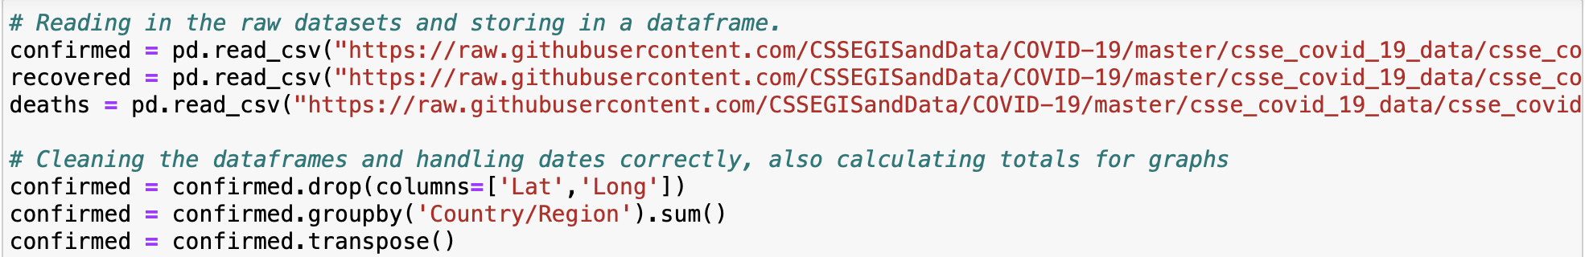
Transforming the Dataset
I read in the raw data, I then removed the ‘Lat’ and ‘Long’ columns as these were not required to plot the graphs.
I then used the groupby() function to combine all cases/deaths/recoveries of countries that had several different states or territories.
Finally to make the dataset easier to access and plot the graphs required I transposed the dataset, which changed the columns and rows around.

Slide 4

Dealing with Dates
The next problem that needed to be dealt with was how Pandas would interpret the dates from the dataset and how I would need to ensure these dates were correct so that the graphs would be plotted correctly.
To do this I used the pd.to_datetime function to convert the indexes of the dataset, which were strings, to datetime arguments. I then sorted the dataset by date, so it was in chronological order. Finally I set the index of the dataset to the datetime arguments that were created.
This allowed me to plot the graphs using the dates as values for the x-axis.

Slide 5

Rolling Averages
For Visualisation 1, we were required to calculate a 3-day rolling/moving average for all 3 sets of data.
To do this I used .rolling(window) function to do a 3-day rolling window.

Slide 6
Days from 100th Case/10th Death
I first had a check that dropped any columns(countries) that did not have 100 cases/10 deaths, recoveries yet.
I then separated the countries that needed to be highlighted and the countries that were to be left as grey line plots.
After that I iterated through both sets of countries, column by column and stored all entries after the first entry >= 100 cases or 10 deaths.
I then plotted that column onto the graph

Slide 7
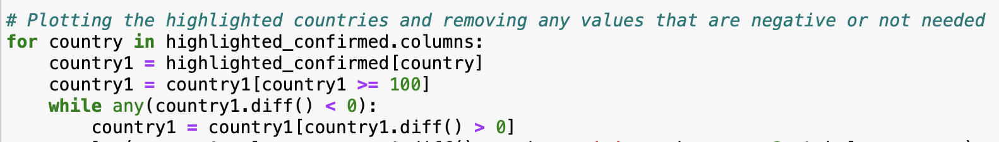
Visualization 3 – Data correction/Negative Values
One of the things that had to be dealt with was the fact that some countries had a drop in total cases/deaths/recoveries. This was the equivalent of a date correction in their statistics.
This meant that there would be y-axis values that would be negative which would produce irrational log values since there were decreases on daily cases/deaths/recoveries.
To deal with this, I set up a loop that removed all the values after the data correction until the number of cases/deaths/recoveries was >= the last data entry before the data correction.

Slide 8
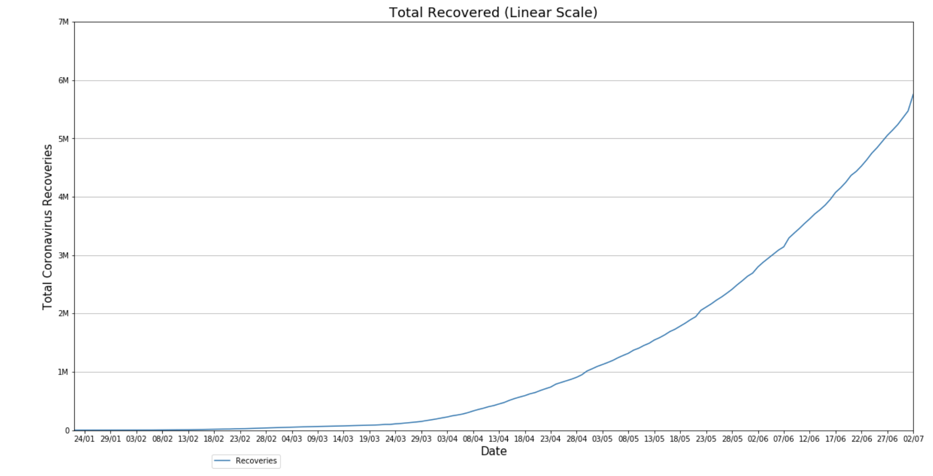
Visualisation 1(a) – Recoveries by Country

Slide 9
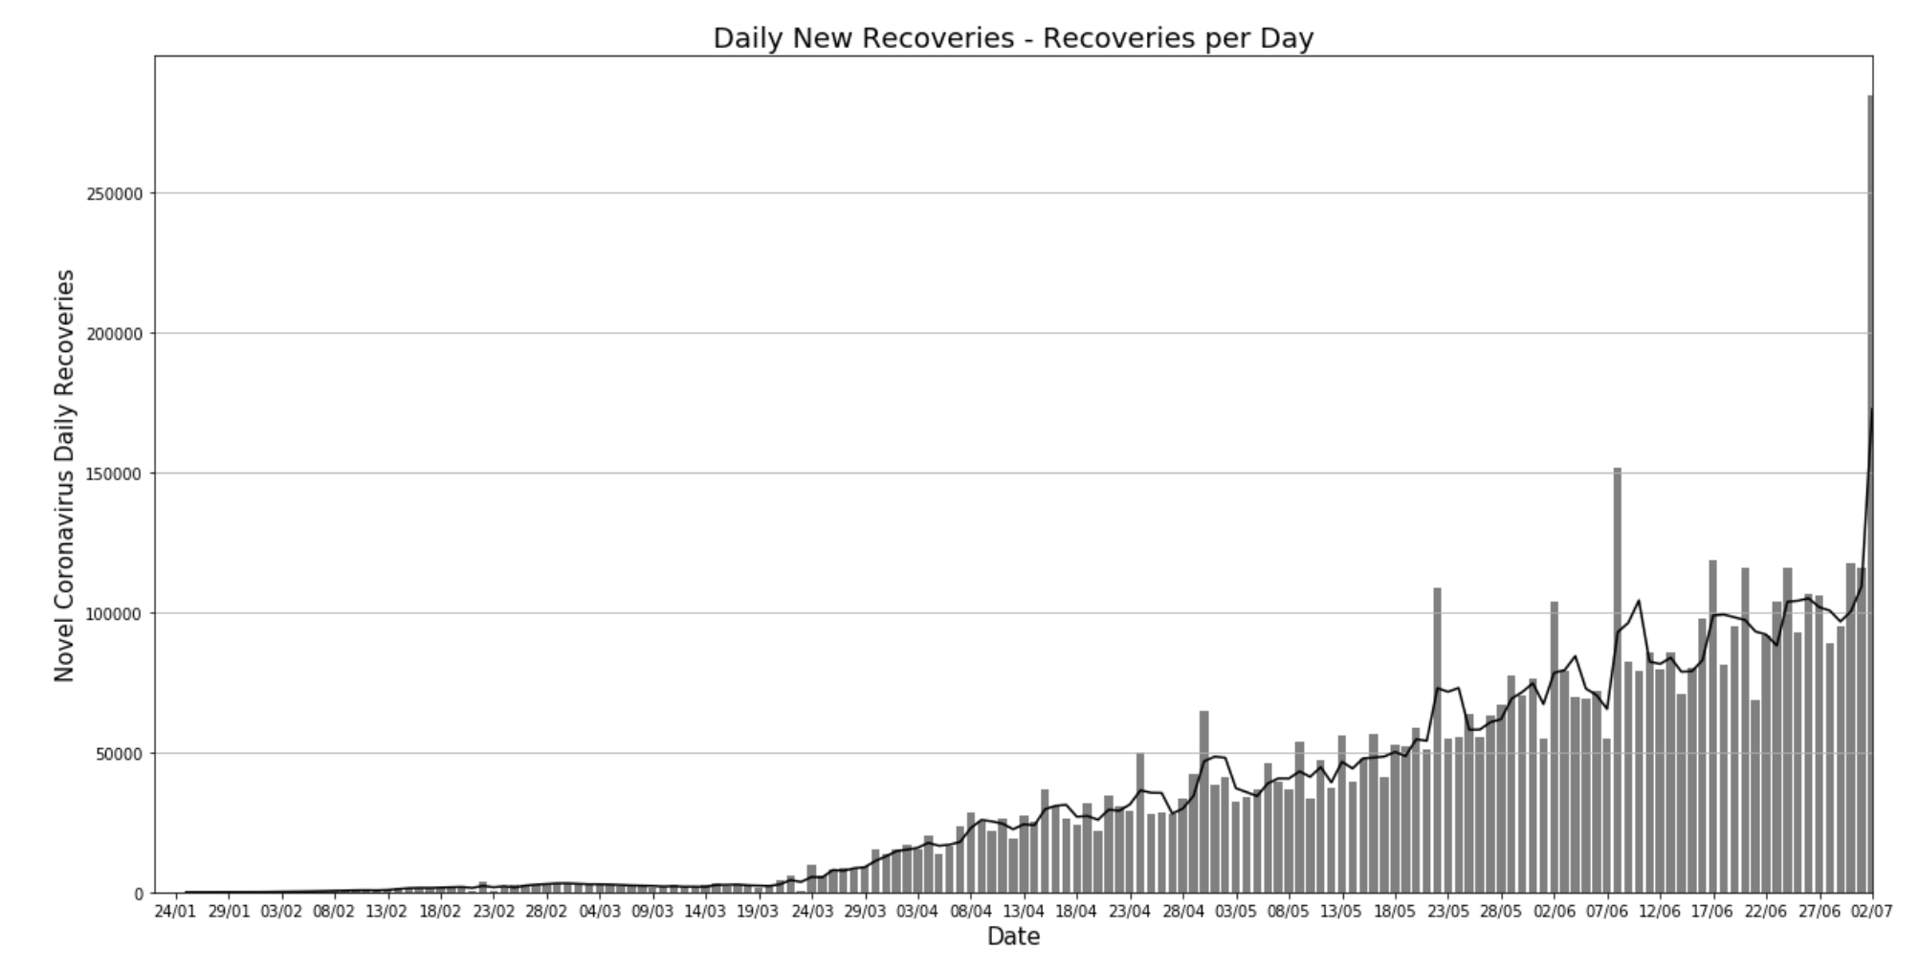
Visualisation 1(b) – Recoveries by Country with Rolling Averages

Slide 10
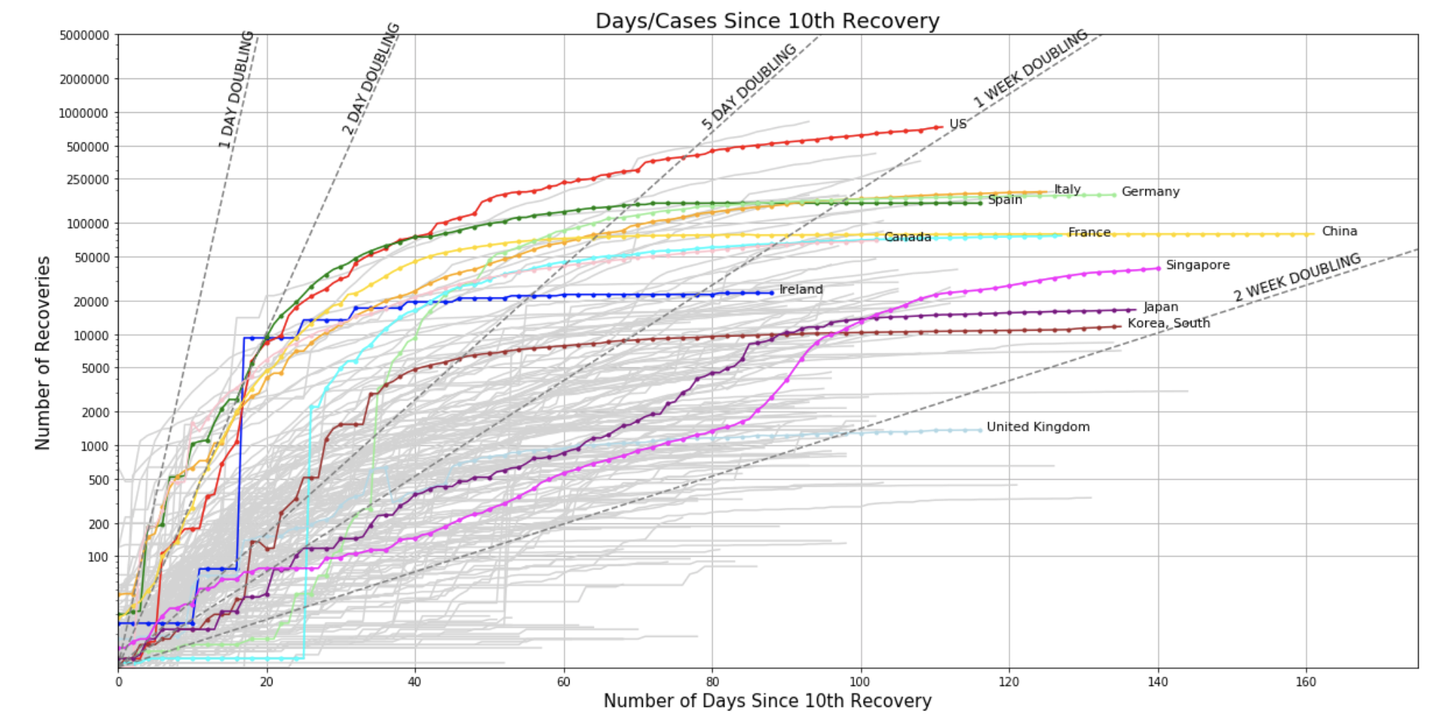
Visualisation 2 – Recoveries by Time

Slide 11
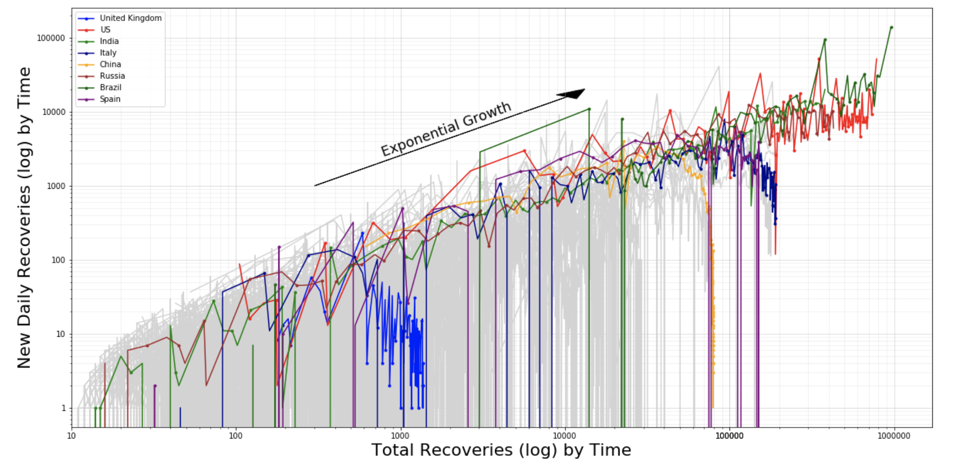
Visualisation 3 – New Recoveries vs Total Recoveries

Slide 12
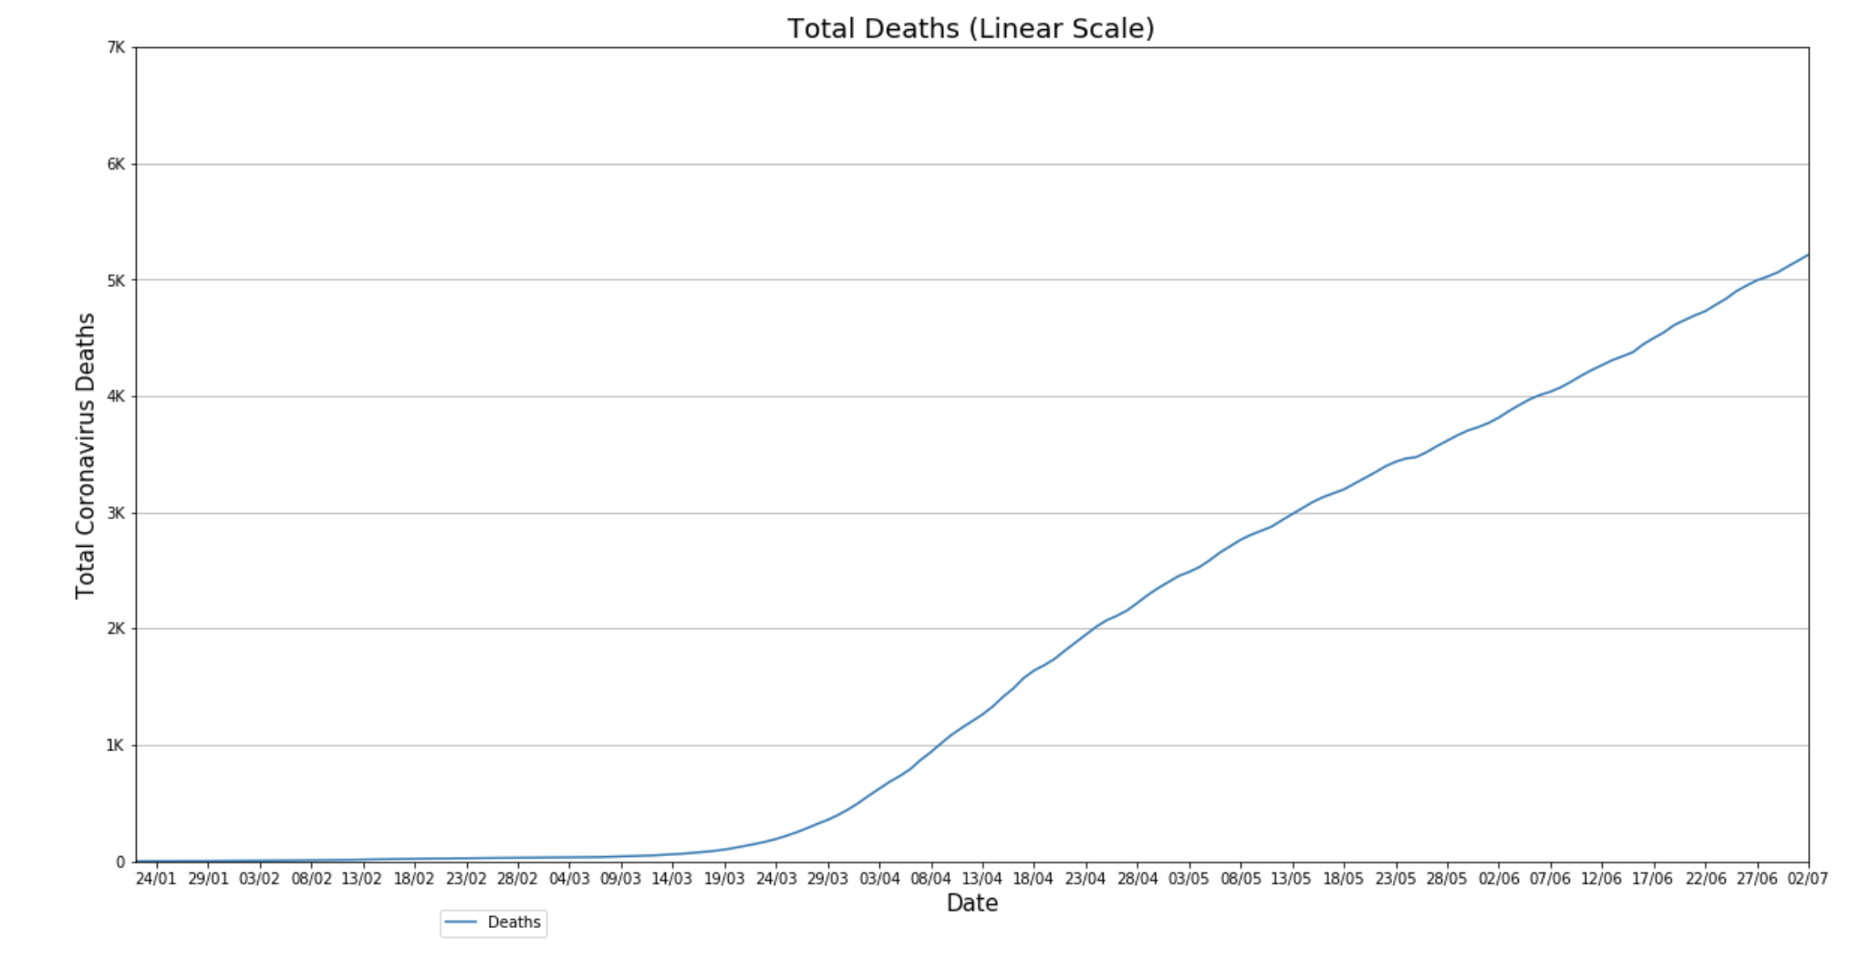
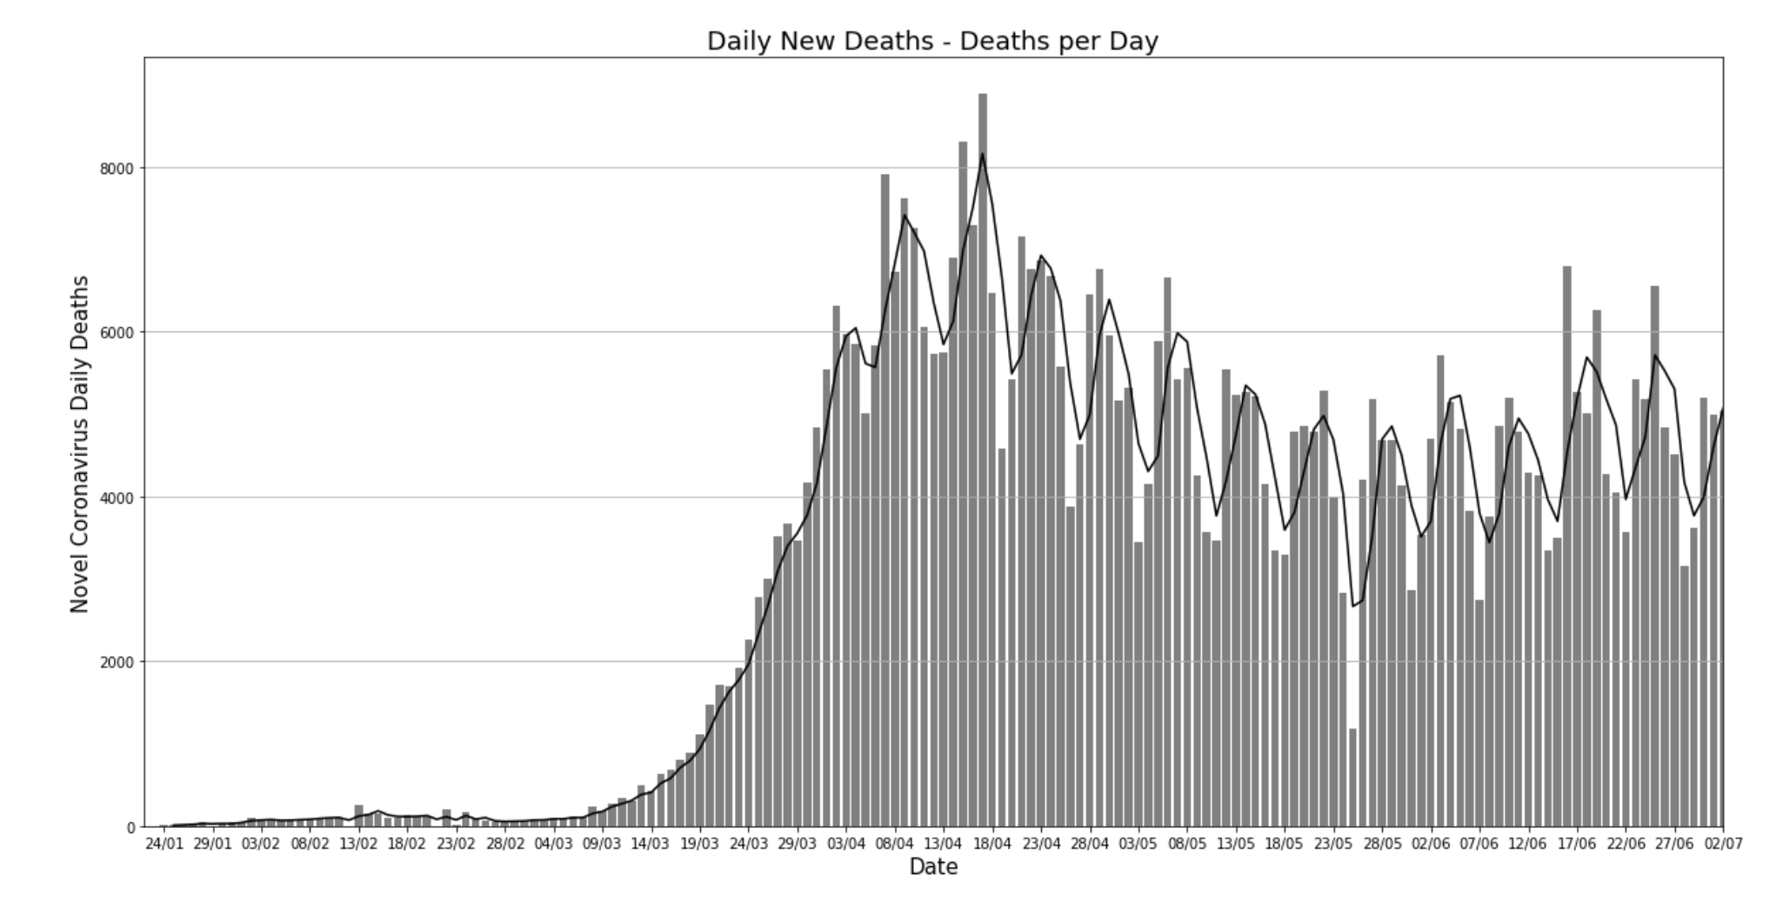
Appendix – Visualization 1(Deaths)

Slide 13
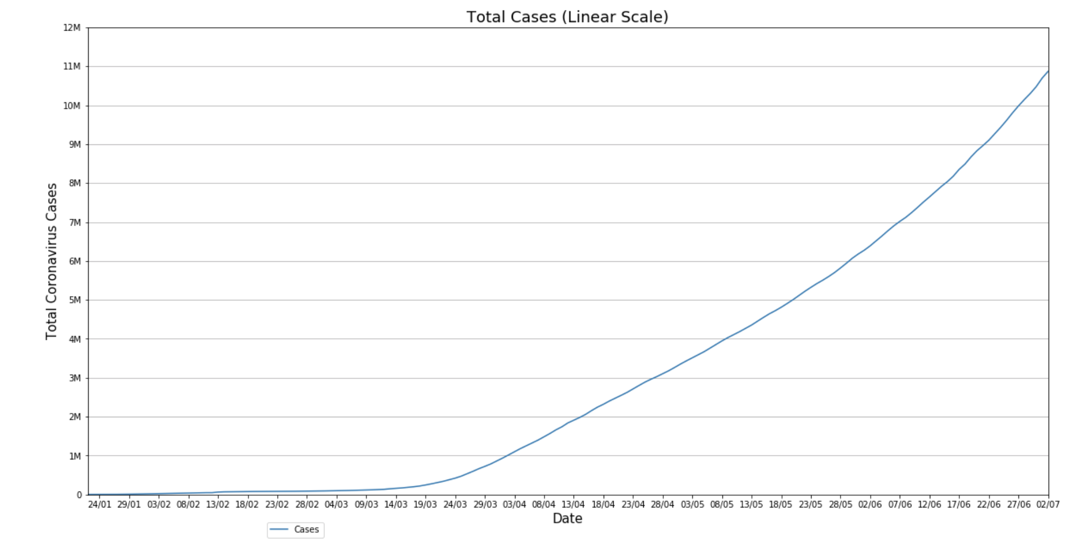
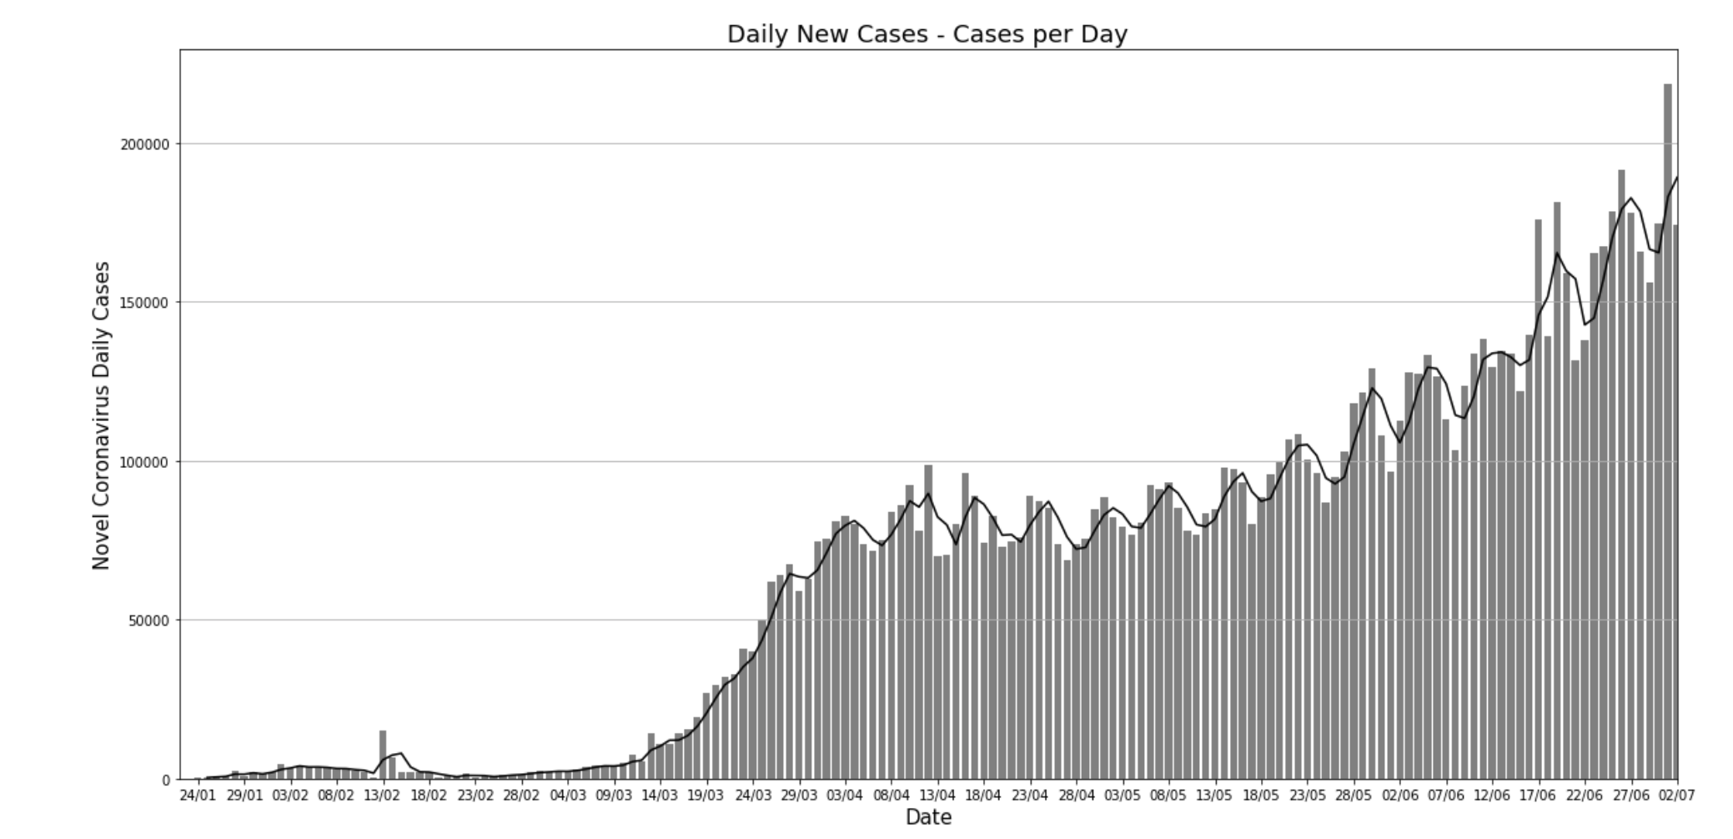
Appendix – Visualization 1(Cases)

Slide 14
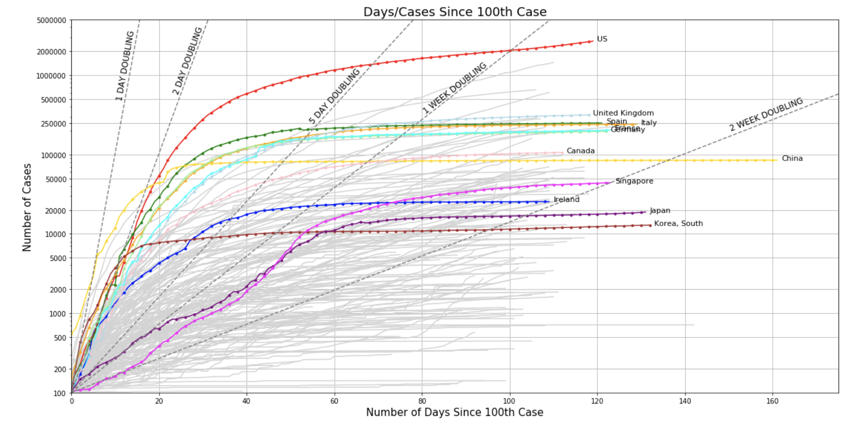
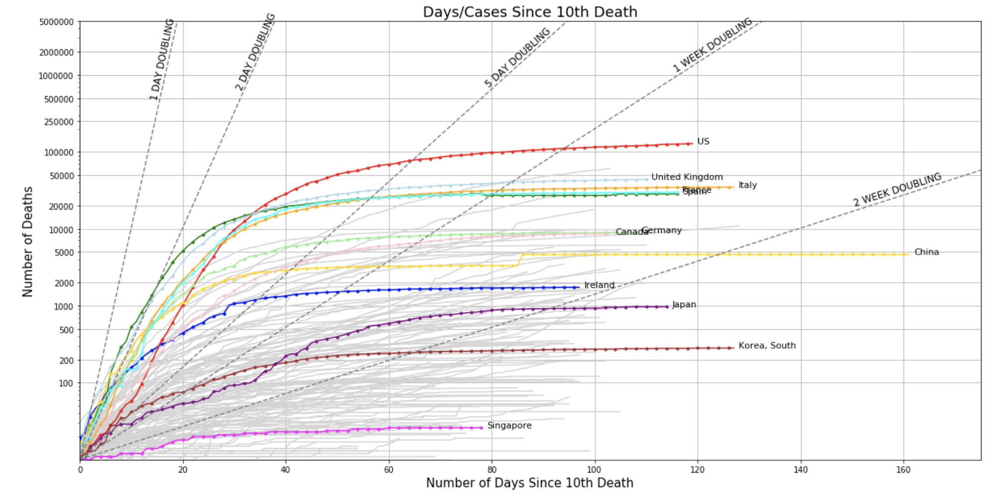
Appendix – Visualization 2(Cases/Deaths)

Slide 15
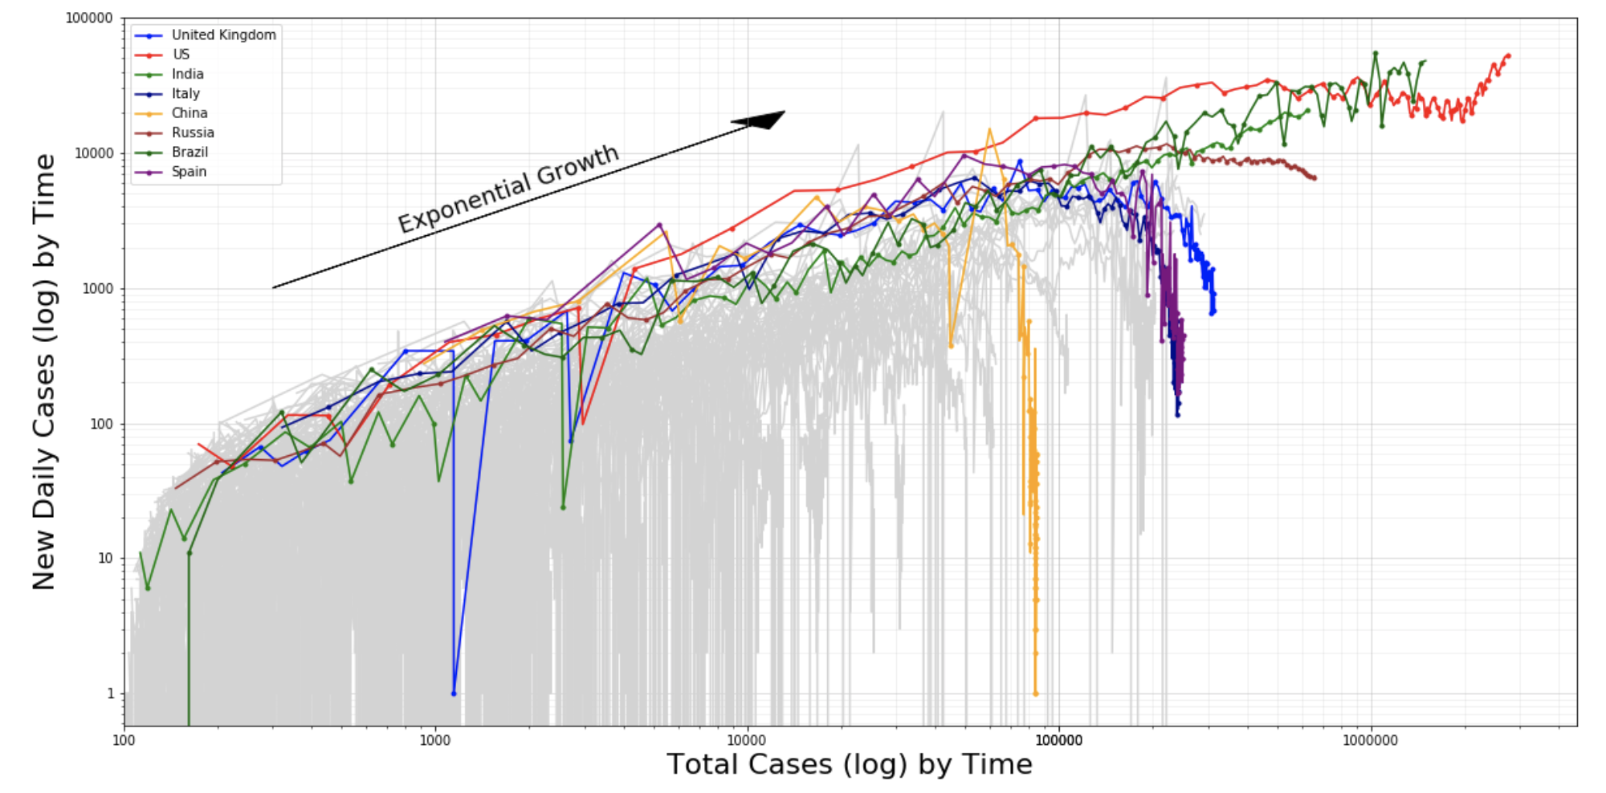
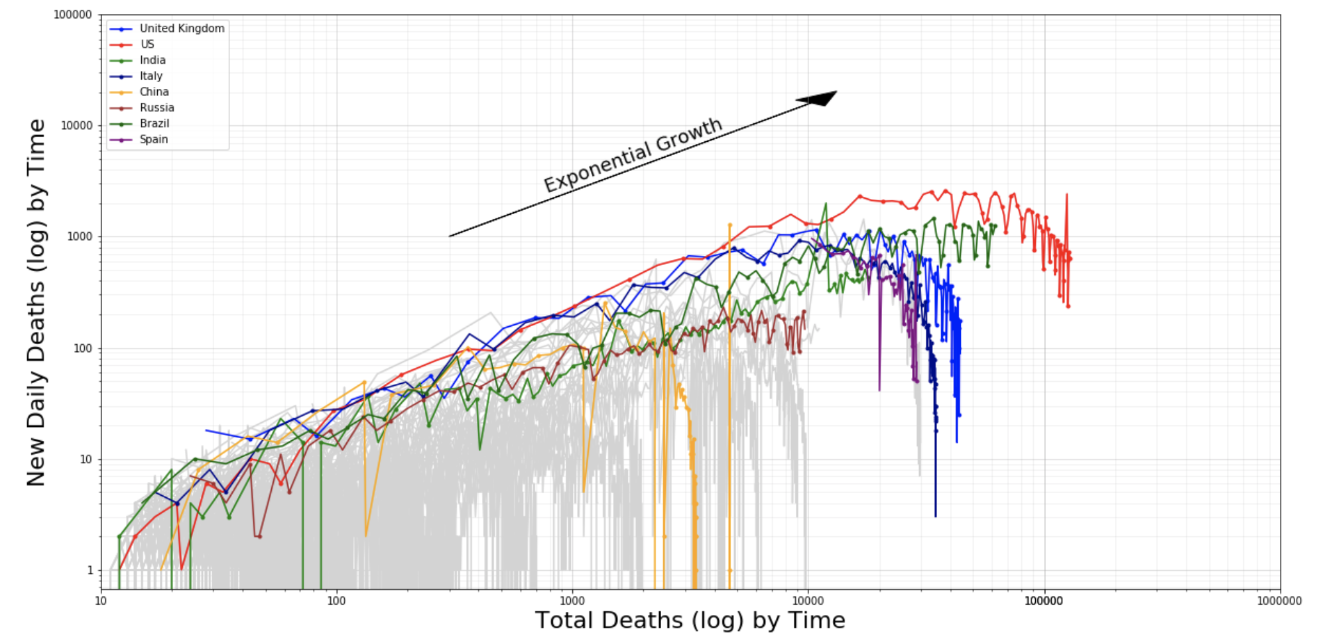
Appendix – Visualization 3 (Cases/Deaths)

